Slide 1
Histogram Processing
Part - 1
Histogram Equalization: Continuous Case

Slide 2
Quick Recap
Image Representation
Binary
Grayscale
Color
Pixel Neighborhood
Adjacency,
Connectivity
Path

Slide 3
Agenda
What is a histogram?
Histogram based Contrast Enhancement
Histogram Equalization
Continuous case
Discrete Case
Histogram Specification (matching)
Continuous case
Discrete Case

Slide 4
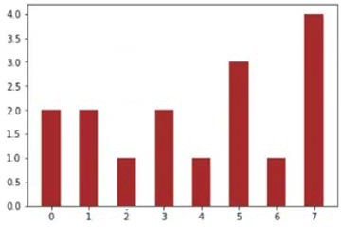

















Histogram
What is a histogram?
Size: 4 x 4
A 3-bit image
Corresponding histogram
Representation: 2D matrix
Representation: 1-D matrix (vector)
3 | 7 | 1 | 3
0 | 2 | 5 | 4
6 | 7 | 1 | 0
7 | 7 | 5 | 5
h =
2 | 2 | 1 | 2 | 1 | 3 | 1 | 4
Black: 0
White: 7
I=

Slide 5
Histogram
Notations: In a gray level image, let us consider
L - No. of gray levels in the image (0 to L-1)
r_{k} - The normalized intensity value (gray level), r_{k} ∈ [0,1],
here k ∈ [0,L-1]
n_{k} - No. of pixels with gray level r_{k}
N - Total number of pixels in the image
Using this we can define
– Histogram
– Normalized histogram

Slide 6
Histogram
Histogram h of an image is defined as
h(r_{k})=n_{k} k=0,1,2,..L-1
The probabilities assigned to each gray level can be given by the relation:
𝒏_{𝒌}
= 𝟎 ≤ 𝒓 ≤ 𝟏, 𝒌 = 𝟎, 𝟏, 𝟐 … … . 𝑳 − 𝟏
𝒑_{𝒓} 𝒓_{𝒌}
𝑵
𝒌
The plot of p_{r}(r_{k}) with respect to r_{k} is called normalized histogram of the image

Slide 7
Histogram
Four basic image types and their histograms:
dark
Light
low contrast
high contrast
Their corresponding histograms shown in next few slides

Slide 8
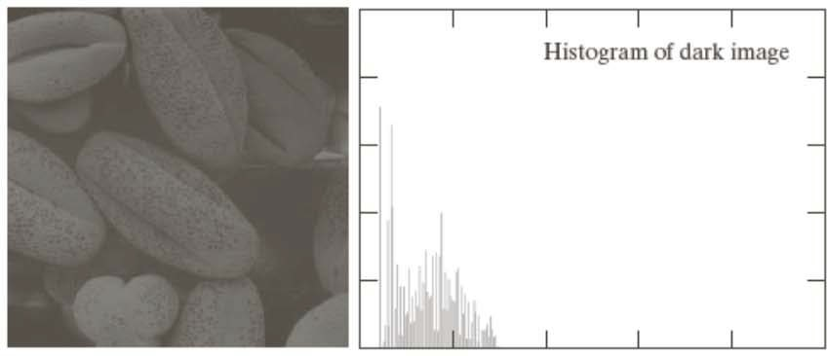
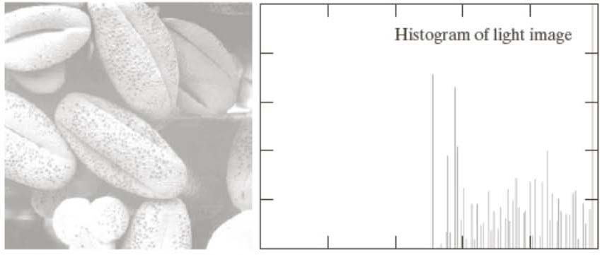
Histogram

Slide 9
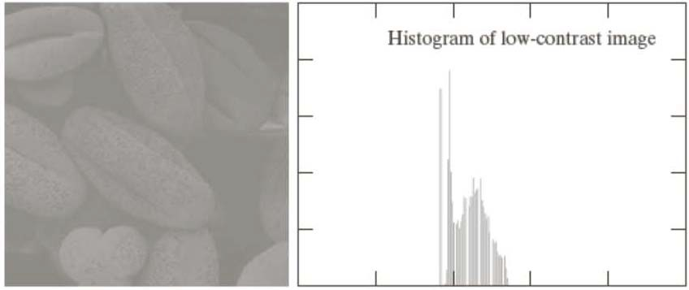
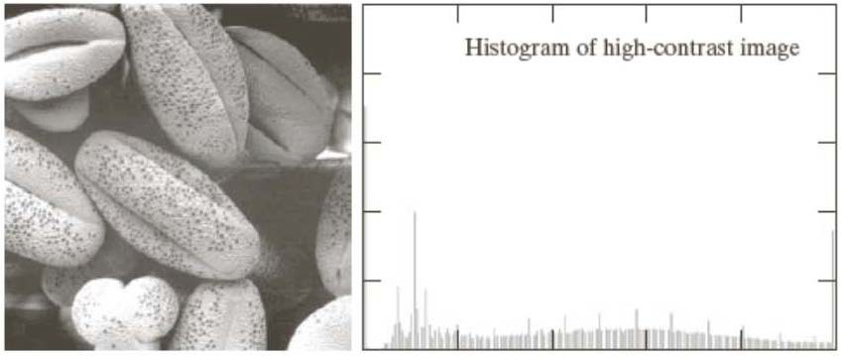
Histogram

Slide 10
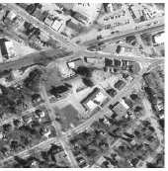
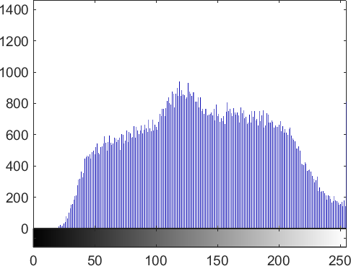
Few more Histogram Examples
Example – 1

Slide 11
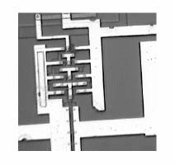
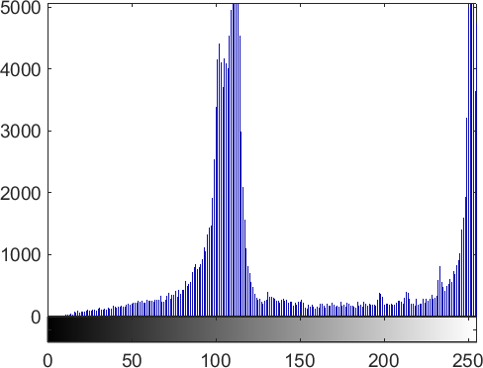
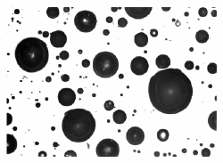
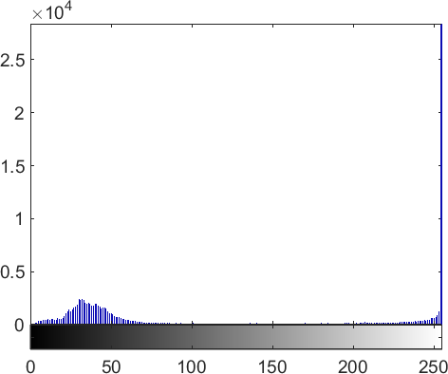
Few more Histogram Examples
Example – 2
Two prominent intensities
Image with white foreground

Slide 12
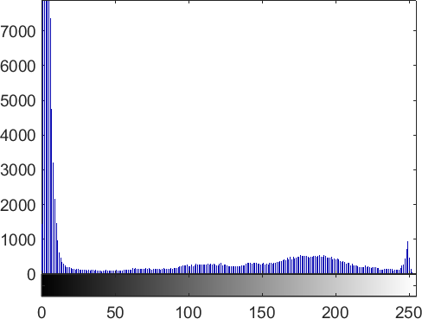
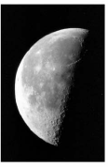
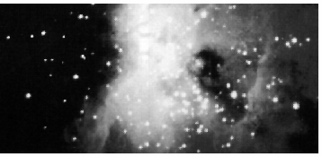
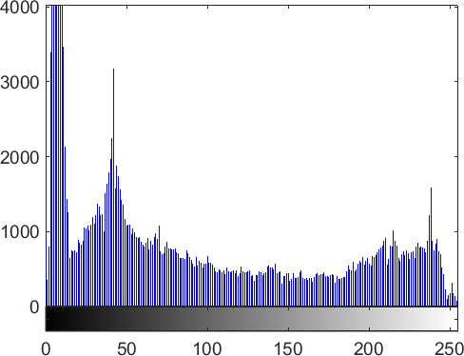
Few more Histogram Examples
Example – 3
Image with more prominent dark background
Image with more or less uniform coloring except the background

Slide 13
Applications of Histogram
Histograms are
simple to calculate
give information about the kind (global appearance) of image and its properties
Image enhancement
Image compression
Image segmentation

Slide 14
Histogram of a Good Image
Intuitively, images whose pixels occupy the entire range of intensity levels and tend to be distributed uniformly will have an appearance of good contrast

Slide 15
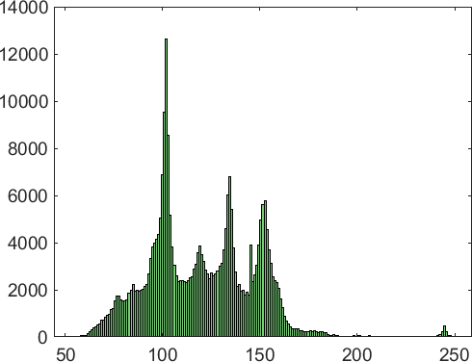
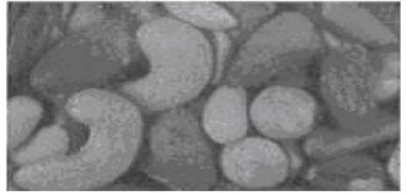
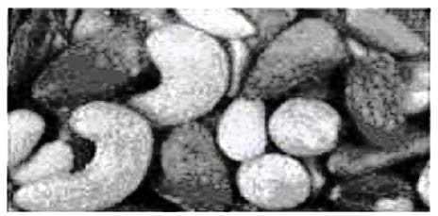
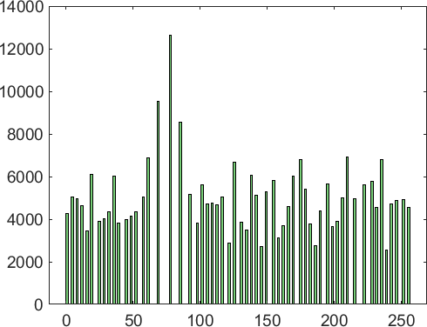
Histogram of a Good Image
Input image & corresponding histogram
Image after histogram equalization & corresponding histogram

Slide 16
Histogram Equalization-Continuous Case
Objectives
– to obtain a uniform histogram for the output image
𝒔
– to obtain a transformation function T(r) which gives such transformation
Consider:
r represents the gray levels of image to be enhanced
It is normalized in the range [0,1]
r = 0 represents black
r = 1 represents white
Objective is to get s = T(r) transformation that produces a level s for every pixel level r in the original image to get uniform histogram
1
0
1
𝒓
𝑻(𝒓)

Slide 17
Histogram Equalization-Continuous Case
Constraint on T(r)
T(r) should satisfies the following conditions
T(r) is monotonically increasing where r is in the range [0,1]
This condition ensures that output intensity values will never be less than corresponding input values, thus preventing artifacts created by reversals of intensity
T(r) also varies in the range [0,1]
This condition ensures that resulting gray levels are in the same range as input levels
Note
–
if T(r) is monotonically increasing, it is possible that multiple values of r to
map to a single value of s

Slide 18
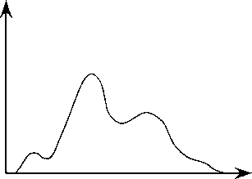
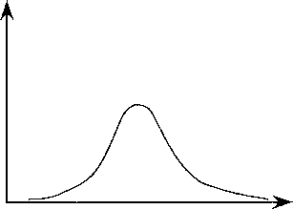
Histogram Equalization-Continuous Case
Normalized histogram can be considered as a pdf
– gray levels in an image can be viewed as random variables in the interval [0, 1]
Histogram
Normalized Histogram (pdf)
frequency
frequency
Area under a pdf is equal to 1
r
r

Slide 19
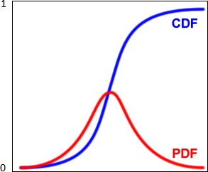
Histogram Equalization-Continuous Case
Cumulative Distribution Function (cdf) corresponding to a pdf is found to be a good choice for T(r)
Both constraints satisfied for this T(r)
T(r) is single valued and monotonically increasing
T(r) varies in the range [0,1]

Slide 20
cdf is a good choice for T(r) – Let us check this?
Consider normalized histogram (pdf) of the image.
We have two histograms (pdfs)
p_{r} is a probability distributions on r of input image
p_{s} is the probability distributions on s of transformed image
Then the probability of a gray level value r in the range dr should be same in the transformed image at gray level s and range ds
𝒅𝒓
𝒑_{𝒔} 𝒔 = 𝒑_{𝒓} 𝒓
𝒅𝒔
So the pdf of s depends on pdf of r and the transformation function

Slide 21
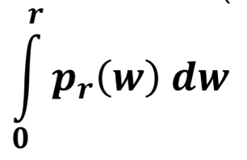
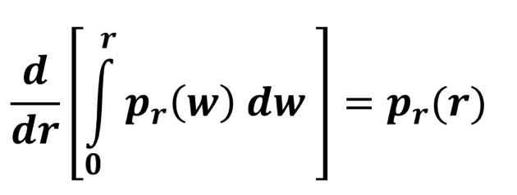
cdf is a good choice for T(r) – Let us check this?
Consider the cumulative distribution function (cdf) as the transformation function T(r)
𝒔 = 𝑻 𝒓 =
Applying the leibniz rule
𝒅𝒔 𝒅𝑻(𝒓)
=
𝒅𝒓 𝒅𝒓
=
Substituting this into the first equation we get
𝒅𝒓 𝟏
𝒑_{𝒔} 𝒔 = 𝒑_{𝒓} 𝒓
= 𝒑_{𝒓} 𝒓 = 𝟏, 𝟎 ≤ 𝒔 ≤ 𝟏
𝒅𝒔 𝒑 𝒓
𝒓
This shows that that transformation T(r) obtained based on cdf produces uniform distribution

Slide 22
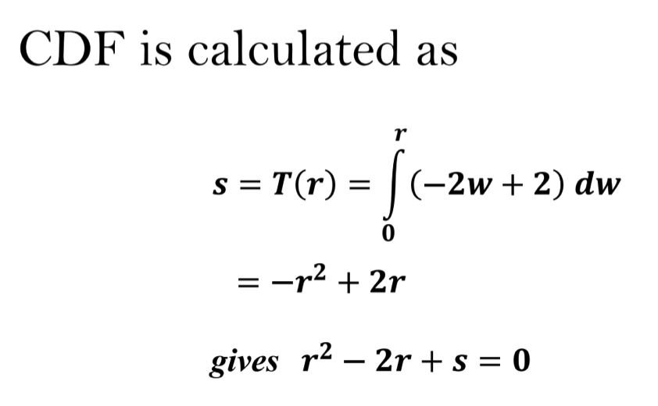
Histogram Equalization-Continuous Case
Examples
PDF of input image
𝒑_{𝒓} 𝒓 = −𝟐𝒓 + 𝟐, 𝟎 ≤ 𝒓 ≤ 𝟏
2
𝑷_{𝒓}(𝒓)
0
1
1
𝒔
𝑻(𝒓)
0
1
𝒓

Slide 23
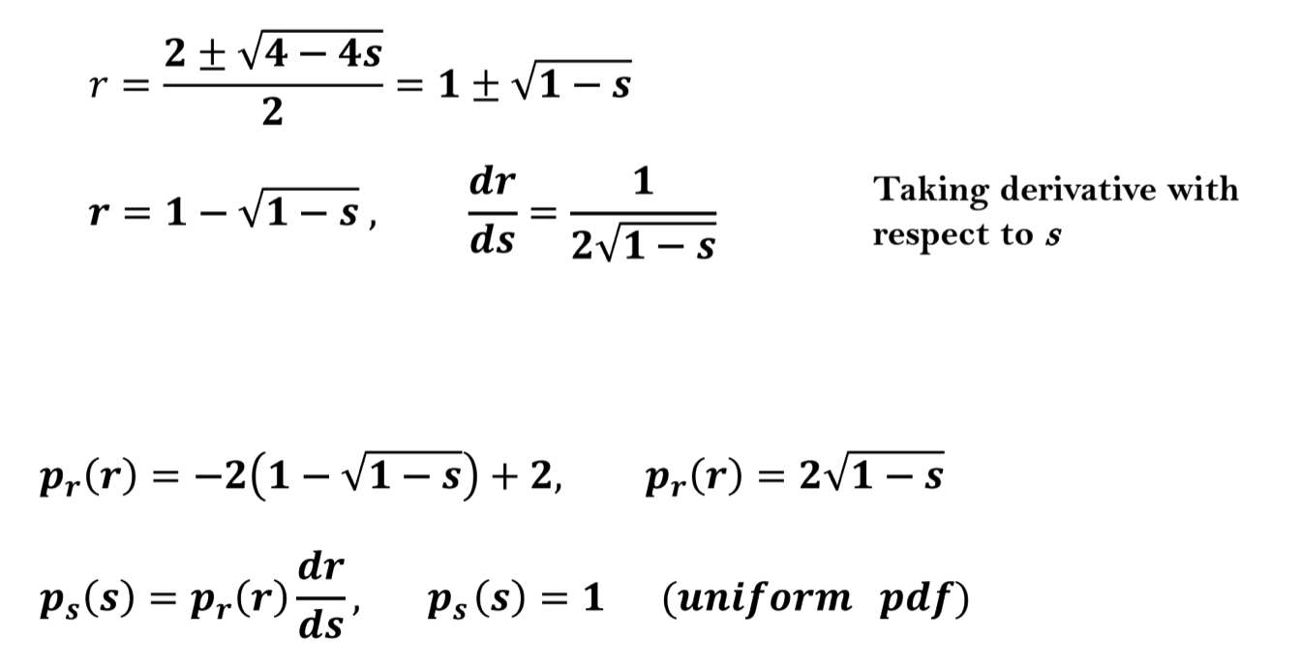
Histogram Equalization-Continuous Case

Slide 24
Histogram Equalization-Inverse Transformation
The inverse transformation from s back to r is denoted by r = T⁻¹(s)
To define inverse transformation, function T(r) should be strictly monotonically increasing function, i.e.
– T(r₁) < T(r₂) if r₁ <r₂
Strictly monotonically increasing function guarantees that mapping from s
to r will be one-to-one thus preventing ambiguities
Hence, if transfer function s=T(r) is strictly monotonically increasing, it gives one-to-one mapping both ways
We need such T(r) when we talk about inverse in some cases [i.e. r = T⁻¹(s)]
This is required in histogram matching (specification)

Slide 25
Histogram Equalization-Inverse Transformation
Hence, to get inverse transform, we need T(r) to be one- to-one and onto (bijective)
If T(r) is one-to-one and onto, inverse transformation r_{k}=T⁻¹(s_{k}) also satisfies both the conditions (one to one and onto) in the continuous case

Slide 26
Histogram Equalization-Inverse Transformation
However, in case of discrete histogram, it is possible if the input image has all the gray levels
Hence, Inverse Transformation r = T⁻¹(s) in discrete case satisfies conditions of
It being strictly monotonically increasing, and
For it, 0 <=T(r_{k})<=1, 0<=r_{k}<=1
only if none of the levels r_{k}, k=0,..,L-1 are missing from the input image which in turn means none of the components of histogram of input image are zero

Slide 27
End

Slide 28
Histogram Processing
Part - 2
Histogram Equalization: Discrete Case
‹#›
PEC-CS416-Computer Vision
‹#›

Slide 29

Review of Previous Class
Histogram
Normalized Histogram
3-Bit Image and Its Histogram
Histogram of a Good Image (in terms of contrast)
– Intuitively, a good image has uniformly distributed histogram in the entire range of available gray values
‹#›
‹#›
PEC-CS416-Computer Vision

Slide 30

Review of Previous Class
𝒔
Histogram Equalization
Used for contrast enhancement
Provides a transformation function T(r) to get uniformly distributed histogram
CDF of a PDF (normalized histogram) serves as a good T(r)
1
0
1
𝒓
𝑻(𝒓)
𝑻(𝒓)
‹#›
‹#›
PEC-CS416-Computer Vision

Slide 31
Agenda
Histogram Equalization
–Discrete Case
Histogram Equalization
–Discrete Case Examples
‹#›
‹#›
PEC-CS416-Computer Vision

Slide 32
Histogram – Notations used
In a gray level image, let us consider
L - No. of gray levels in the image
r_{k} - The normalized intensity value (gray level), r_{k} ∈ [0,1], Here, k ∈ [0,L-1]
n_{k} - No. of pixels with gray level r_{k}
N - Total number of pixels in the image
Using this, we can define
Histogram
Normalized histogram
‹#›
‹#›
PEC-CS416-Computer Vision

Slide 33
Histogram Equalization – Continuous Case
p_{r}(r): the input probability density function (pdf)
a non-uniform continuous pdf
p_{s}(s): a pdf that is 0 outside the interval [0,1] and 1 in the interval [0,1]
a uniform density
Obtained after histogram equalization
T(r) is the transformation function to get p_{s}(s) from p_{r}(r)
T(r) depends on p_{r}(r) but p_{s}(s) is always a uniform pdf
‹#›
‹#›
PEC-CS416-Computer Vision

Slide 34
Histogram Equalization-Discrete Case
Example of histogram equalization in discrete domain
–histogram equalization on an image
‹#›
‹#›
PEC-CS416-Computer Vision

Slide 35
Histogram Equalization – Discrete Case
In discrete case, r takes discrete gray values r_{k} , k=0,1…L-1 and
Probability of occurrence of a gray level r_{k} in an image is
approximated by:
𝒏_{𝒌}
= ,
𝒑_{𝒓} 𝒓
𝒌 = 𝟎, 𝟏, ……., 𝑳−𝟏
𝑵
This defines
normalized histogram
(pdf) for discrete case
‹#›
‹#›
PEC-CS416-Computer Vision

Slide 36
Histogram Equalization – Discrete Case
Considering transformation function as cdf for histogram equalization, it can be given as
𝒌
𝒌
𝒔_{𝒌} = 𝑻 𝒓_{𝒌} = ∑ 𝒑_{𝒓}(𝒓_{𝒋}) = ∑ 𝒏_{𝒋}⁄𝑵
𝒋=𝟎
𝒋=𝟎
where
𝟎 ≤ 𝒓_{𝒌} ≤ 𝟏, 𝒌 = 𝟎, 𝟏, 𝟐, … … , 𝑳 − 𝟏
n_{j} is the number of times the j^{th} gray level appears in the image
L defines the number of gray levels
p_{r}(r_{j}) is the probability that a pixel holds j^{th} gray level and
N is the total number of pixels in the image
Unlike the continuous part, the discrete transformation may not produce the discrete equivalent of a uniform pdf, nevertheless, it spreads the histogram to span a larger range
‹#›
‹#›
PEC-CS416-Computer Vision

Slide 37
Histogram Equalization – Discussion
ALGORITHM
INPUT: Input image which need to be enhanced
OUTPUT: Output image after histogram equalization
Equalization
Compute normalized histogram p_{r}(r)
Calculate normalized sum of histogram (cdf) and use as T(r)
Transform input image to output image using T(r)
‹#›
‹#›
PEC-CS416-Computer Vision

Slide 38
Examples of Histogram Equalization
Discrete Case
(a) r_{k} | (b) n_{k} | (c) p_{r}(r_{k})
0 | 790 | 0.19
1/7 | 1023 | 0.25
2/7 | 850 | 0.21
3/7 | 656 | 0.16
4/7 | 329 | 0.08
5/7 | 245 | 0.06
6/7 | 122 | 0.03
1 | 81 | 0.02
Total | 4096 | 1.00
(d) Cdf = s_{k} | (e) Quantized Value
0.19 | 1/7
0.44 | 3/7
0.65 | 5/7
0.81 | 6/7
0.89 | 6/7
0.95 | 1
0.98 | 1
1.00 | 1
(a) Quantized Gray levels; (b) histogram; (c) its pdf, (d) Computed CDF & (e) approx. to the nearest gray level
‹#›
‹#›
PEC-CS416-Computer Vision

Slide 39
Examples of Histogram Equalization
Discrete Case
(a) r_{k} | (b) n_{k} | (c) p_{r}(r_{k})
0 | 790 | 0.19
1/7 | 1023 | 0.25
2/7 | 850 | 0.21
3/7 | 656 | 0.16
4/7 | 329 | 0.08
5/7 | 245 | 0.06
6/7 | 122 | 0.03
1 | 81 | 0.02
Total | 4096 | 1.00
(a) r_{k} | s_{k}=T(r)
0 | 1/7
1/7 | 3/7
2/7 | 5/7
3/7 | 6/7
4/7 | 6/7
5/7 | 1
6/7 | 1
1 | 1
s_{k} | n_{k} | p_{s}(s_{k})
0 | 0 | 0
1/7 | 790 | 0.19
2/7 | 0 | 0
3/7 | 1023 | 0.25
4/7 | 0 | 0
5/7 | 850 | 0.21
6/7 | 985 | 0.24
1 | 448 | 0.11
Original Histogram
Transformation function
The new histogram
‹#›
PEC-CS416-Computer Vision
‹#›

Slide 40
Examples of Histogram Equalization
Discrete Case
0.3
0.25
0.3
0.2
T(r) _{0.15}
0.25
0.2
p_{s}(s_{k}) _{0.15}
0.1
Series1
0.1
0.05
0.05
0
0
0
1/7
2/7
3/7
4/7
5/7
6/7
7/7
0
1/7
2/7
3/7
4/7
5/7
6/7
7/7
r
s
‹#›
PEC-CS416-Computer Vision
‹#›

Slide 41
Plots for p_{r}(r) and p_{s}(s)
0.3
0.25
0.2
0.15
pr(r)
ps(s)
0.1
0.05
0
0
1/7
2/7
3/7
4/7
5/7
6/7
1
Gray levels 🡪
‹#›
‹#›
PEC-CS416-Computer Vision

Slide 42
Plots for p_{r}(r) and p_{s}(s)
0.3
0.25
0.2
0.15
pr(r)
ps(s)
0.1
0.05
0
0
1/7
2/7
3/7 4/7
Gray levels 🡪
5/7
6/7
1
‹#›
‹#›
PEC-CS416-Computer Vision

Slide 43
Examples of Histogram Equalization
Original Image
Original Histogram
Histogram Equalized Image
Histogram after Equalization
‹#›
PEC-CS416-Computer Vision

Slide 44
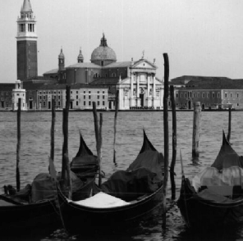
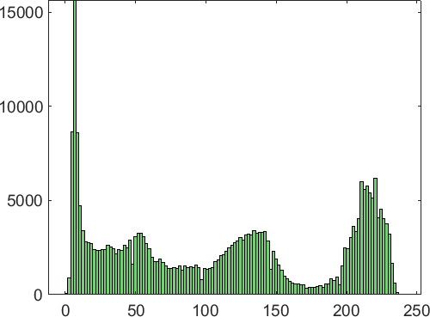
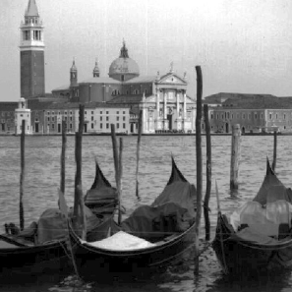
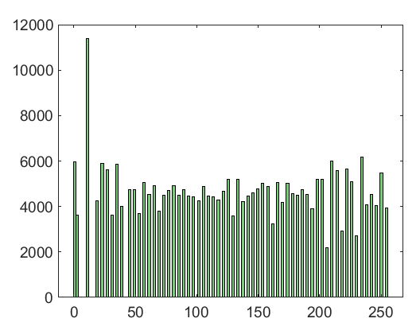
Examples of Histogram Equalization
Original Image
Original Histogram
Histogram Equalized Image
Histogram after Equalization
‹#›
PEC-CS416-Computer Vision

Slide 45
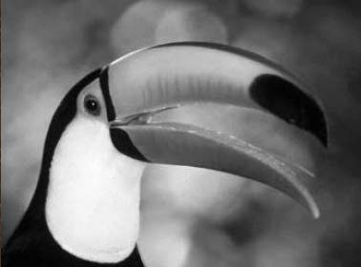
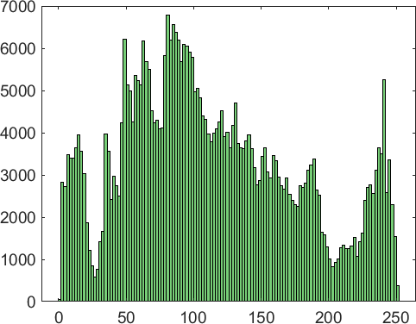
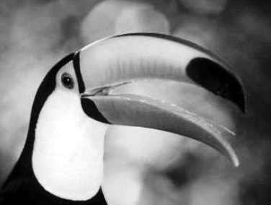
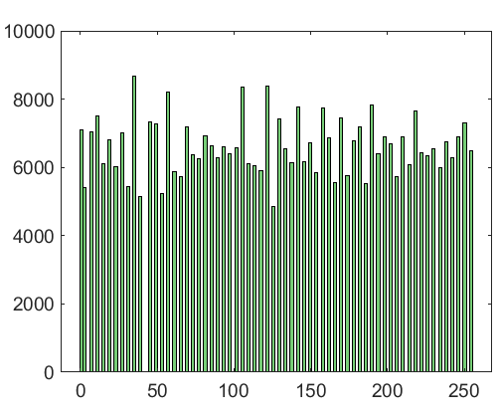
Examples of Histogram Equalization
Original Image
Original Histogram
Histogram Equalized Image
Histogram after Equalization
‹#›
PEC-CS416-Computer Vision

Slide 46
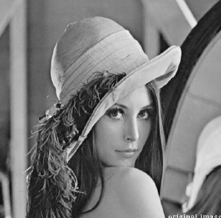
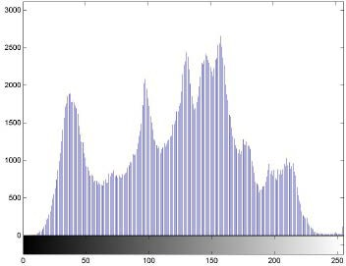
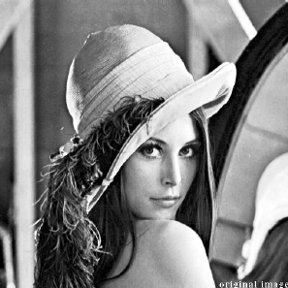
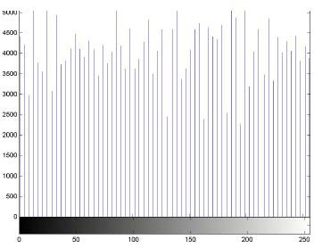
Examples of Histogram Equalization
‹#›
PEC-CS416-Computer Vision

Slide 47
Histogram Equalization - Summary
Goal of histogram equalization is to obtain a uniform histogram for the output image
Histogram equalization causes a histogram with closely grouped values to spread out into a flat region.
Spreading or flattening the histogram makes the dark pixels appear darker and the light pixels appear lighter
‹#›
‹#›
PEC-CS416-Computer Vision

Slide 48
Histogram Equalization - Summary
Histogram equalization is a point process
Histogram equalization does not introduce new intensities in the image
Existing values will be mapped to new values keeping actual number of intensities in the resulting image equal or less than the original number of intensities
‹#›
‹#›
PEC-CS416-Computer Vision

Slide 49
End
PEC-CS416-Computer Vision

Slide 50
Histogram Processing
Part - 3
Histogram Specification
(Histogram Matching)

Slide 51
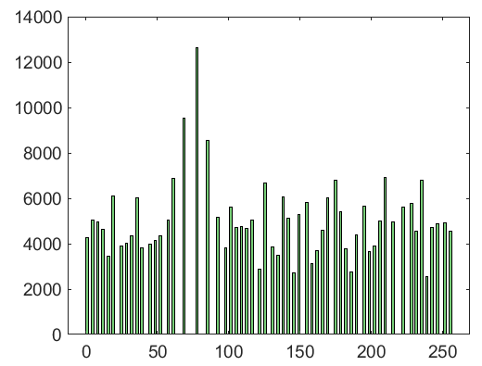
Quick Review: Histogram Equalization
Histogram equalization transforms
– an input histogram of an image an equalized (uniform) histogram
Original Histogram
Original Image
Histogram Equalized Image
Histogram after Equalization

Slide 52
Agenda
Histogram Specification
– Also known as Histogram Matching

Slide 53
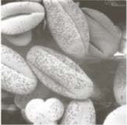
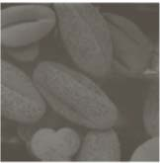
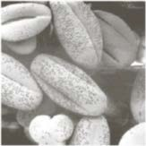
Histogram Specification
0
255
Target Image
0
255
0
255
Input Image
Output Image

Slide 54
Histogram Specification
Histogram specification provides a gray level transformation such that the histogram of the output image matches to that of the pre-specified histogram of a target image

Slide 55




Histogram Specification - Flow Diagram
A(x, y) Input Image
T(x, y) Target Image
C(x, y) Output Image
HT(DT)
HC(DC)
HA(DA)
0
DT
255
0
DA
255
0
DC
255
Input
Target
Output

Slide 56
Histogram Specification - Steps
Mapping function can be found in three steps:
–Equalize the histogram of the input image
–Equalize the specified histogram
–Relate the two equalized histograms

Slide 57
Development of the Method (Continuous Case)
Notations
Continuous gray levels r and z are of the input and the target image
respectively
Their corresponding pdfs are p_{r}(r) and p_{z}(z)
Let s and v be the random variables with the property
r
s = T (r) = ∫ p_{r} (w)dw
z
v = G(z) = ∫ p_{z} (t)dt = s
0
and
0
Ideally, we would want G(z) = T(r)
So, z must satisfy the condition 𝑧 = 𝐺⁻¹[𝑇(𝑟)]

Slide 58
Development of the Method (Discrete Case)
Histogram is first obtained for both the input and target images
The histogram of input image is then equalized using the formula
n_{j ,}
k k
=
∑
∑
s_{k} = T (r_{k} )
P (r ) =
r j
n
j =0 j =0
0 ≤ r_{k} ≤ 1, k = 0,1,.., L −1
where
–n is the total number of pixels in the image
–n_{j} is the number of pixels with gray level r_{j}
–L is the number of gray levels

Slide 59
Development of the Method (Discrete Case)
From the given target image p_{z}(z_{i}), we can obtain
k
v_{k} = G(z_{k} ) = ∑_{i=0} p_{z} (z_{i} ) = s_{k} ,
k = 0,1,.., L −1
G(z_{k}) = T(r_{k})
𝑘 = 0,1, . . , 𝐿 − 1
Hence, z_{k} must satisfy the condition
𝑧_{𝑘} = 𝐺⁻¹[𝑇(𝑟_{𝑘})],

Slide 60
Development of the Method (Discrete Case)
Algorithm
INPUT: Input image, Target image
OUTPUT: Output image that has the same characteristic as the target image
Steps:
Read the Input image and the Target image.
Obtain the histogram of the input image and the target image
Equalize the histograms of input and the target images using the equations discussed in previous slides
Calculate the transformation function G of the target Image
Map the original image gray level r_{k} to the final gray level z_{k}

Slide 61
Development of the Method (Discrete Case)
𝒔
𝒍
𝑴apping 𝒇𝒓om 𝒓_{𝒌} to 𝒔_{𝒌}
𝒗ia 𝑻(𝒓)
𝒗
𝑴apping 𝒇𝒓om 𝒛_{𝒌} to 𝒗_{𝒌}
𝒗ia 𝑮(𝒛)
𝒍
𝒗_{𝒒}
𝑮(𝒛)
𝒔_{𝒌}
𝑻(𝒓)
𝒓
𝒗
𝒛
𝟎
𝒓_{𝒌𝒌}
𝑳 − 𝟏
𝟎
𝒛_{𝒌}
𝑳 − 𝟏
𝒍
𝑮(𝒛)
𝒔_{𝒌}
𝑰nverse 𝑴apping 𝒇𝒓om 𝒔_{𝒌} to 𝒛_{𝒌}
z_{k} = G⁻¹ (s_{k}) = G⁻¹[T (r_{k} )],
k = 0,1,.., L −1
_{𝟎}
𝒛_{𝒌}
𝒛
𝑳 − 𝟏

Slide 62
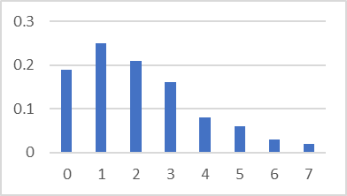
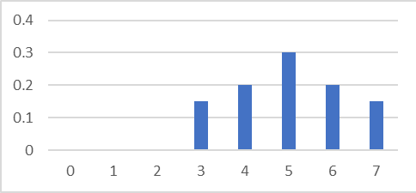
Example
r_{k} | n_{k} | p_{k}(r_{k})
0/7 | 790 | 0.19
1/7 | 1023 | 0.25
2/7 | 850 | 0.21
3/7 | 656 | 0.16
4/7 | 329 | 0.08
5/7 | 245 | 0.06
6/7 | 122 | 0.03
7/7 | 81 | 0.02
z_{k} | p_{z}(z_{k})
0 | 0
1/7 | 0
2/7 | 0
3/7 | 0.15
4/7 | 0.20
5/7 | 0.30
6/7 | 0.20
7/7 | 0.15
Target Histogram
Input Histogram

Slide 63
Example
Equalization of first histogram
r_{k} | p_{k} | Cdf(p_{k}) | Gray Levels (s_{k})
0/7 | 0.19 | 0.19 | 1/7
1/7 | 0.25 | 0.44 | 3/7
2/7 | 0.21 | 0.65 | 5/7
3/7 | 0.16 | 0.81 | 6/7
4/7 | 0.08 | 0.89 | 6/7
5/7 | 0.06 | 0.95 | 1
6/7 | 0.03 | 0.98 | 1
7/7 | 0.02 | 1 | 1
8
7
6
5
s=T(r)
4
3
2
1
0
0
1
2
3
4
r 🡪
5
6
7

Slide 64
Example
Equalization of Second Histogram
z_{k} | p(z_{k}) | cdf(z_{k}) | Gray levels (v_{k})
0 | 0 | 0 | 0/7
1/7 | 0 | 0 | 0/7
2/7 | 0 | 0 | 0/7
3/7 | 0.15 | 0.15 | 1/7
4/7 | 0.20 | 0.35 | 2/7
5/7 | 0.30 | 0.65 | 5/7
6/7 | 0.20 | 0.85 | 6/7
7/7 | 0.15 | 1 | 1
8
7
6
5
v=G(z)
4
3
2
1
0
0
1
2
3
4
5
6
7
8
z 🡪

Slide 65
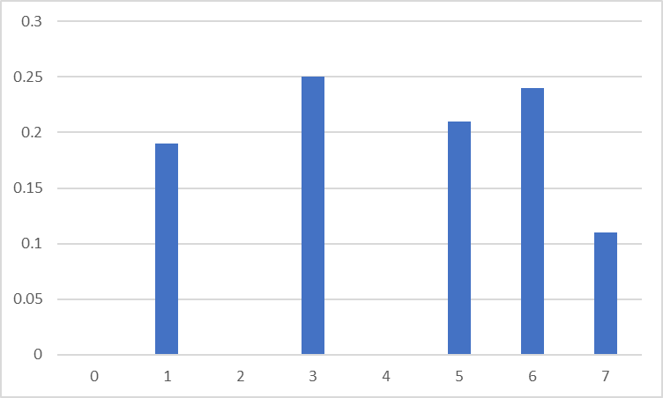
Example
8
7
6
5
s=T(r)₄
3
p_{s}(s_{k})
2
1
0
0
s 🡪
1
2
3
4
5
6
7
r 🡪
8
7
6
5
v =G(z)
4
3
p(z) 🡪
2
1
z 🡪
0
0
1
2
z 🡪
3 4
5
6
7
8

Slide 66






Example
Mapping Step
r_{k} | s_{k}=Cdf(p_{k}) | Gray levels (s_{k})
0/7 | 0.19 | 1/7
1/7 | 0.44 | 3/7
2/7 | 0.65 | 5/7
3/7 | 0.81 | 6/7
4/7 | 0.89 | 6/7
5/7 | 0.95 | 1
6/7 | 0.98 | 1
7/7 | 1 | 1
Gray levels (v_{k}) | v_{k}= G(z_{k}) | z_{k}
0/7 | 0 | 0
0/7 | 0 | 1/7
0/7 | 0 | 2/7
1/7 | 0.15 | 3/7
2/7 | 0.35 | 4/7
5/7 | 0.65 | 5/7
6/7 | 0.85 | 6/7
1 | 1 | 7/7
Mapping Function
0 🡪 | 3
1 🡪 | 4
2 🡪 | 5
3,4 🡪 | 6
5,6,7 🡪 | 7

Slide 67
Example
r_{k} | n_{k} | p_{k}(r_{k})
0/7 | 790 | 0.19
1/7 | 1023 | 0.25
2/7 | 850 | 0.21
3/7 | 656 | 0.16
4/7 | 329 | 0.08
5/7 | 245 | 0.06
6/7 | 122 | 0.03
7/7 | 81 | 0.02
z_{k} | n_{k} | p_{z}(z_{k})
0 | 0 | 0
1/7 | 0 | 0
2/7 | 0 | 0
3/7 | 790 | 0.19
4/7 | 1023 | 0.25
5/7 | 850 | 0.21
6/7 | 985 | 0.24
7/7 | 448 | 0.11
0 | 3
1 | 4
2 | 5
3,4 | 6
5,6,7 | 7
Input Image Histogram
Mapping Function
Output Image Histogram

Slide 68
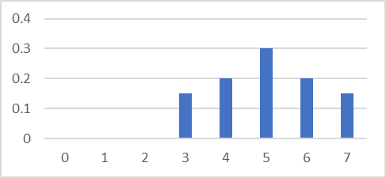
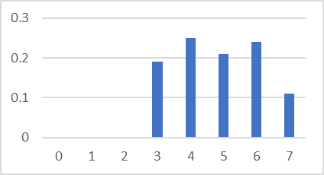
Example
r_{k} | n_{k} | p_{k}(r_{k})
0/7 | 790 | 0.19
1/7 | 1023 | 0.25
2/7 | 850 | 0.21
3/7 | 656 | 0.16
4/7 | 329 | 0.08
5/7 | 245 | 0.06
6/7 | 122 | 0.03
7/7 | 81 | 0.02
z_{k} | p_{z}(z_{k})
0 | 0
1/7 | 0
2/7 | 0
3/7 | 0.15
4/7 | 0.20
5/7 | 0.30
6/7 | 0.20
7/7 | 0.15
z_{k} | n_{k} | p_{z}(z_{k})
0 | 0 | 0
1/7 | 0 | 0
2/7 | 0 | 0
3/7 | 790 | 0.19
4/7 | 1023 | 0.25
5/7 | 850 | 0.21
6/7 | 985 | 0.24
7/7 | 448 | 0.11
Input Histogram
Target Histogram
Output Histogram

Slide 69
End

